Slide 1
UNIT-IV
BACKTRACKING
&
BRANCH AND BOUND

Slide 2
Tackling Difficult Combinatorial Problems
There are two principal approaches to tackling difficult combinatorial problems (NP-hard problems):
Use a strategy that guarantees solving the problem exactly but doesn’t guarantee to find a solution in polynomial time
Use an approximation algorithm that can find an approximate (sub-optimal) solution in polynomial time

Slide 3
Exact Solution Strategies
exhaustive search (brute force)
  useful only for small instances
dynamic programming
  applicable to some problems (e.g., the knapsack problem)
backtracking
  eliminates some unnecessary cases from consideration
  yields solutions in reasonable time for many instances but worst case is still exponential
branch-and-bound
  further refines the backtracking idea for optimization problems

Slide 4
Backtracking
Construct the state-space tree
  nodes: partial solutions
  edges: choices in extending partial solutions
Explore the state space tree using depth-first search
“Prune” nonpromising nodes
  dfs stops exploring subtrees rooted at nodes that cannot lead to a solution and backtracks to such a node’s parent to continue the search

Slide 5
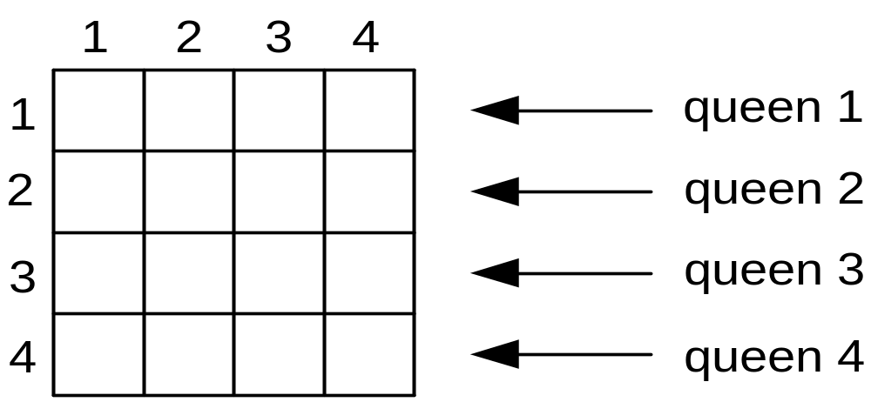
Example: n-Queens Problem
Place n queens on an n-by-n chess board so that no two of them are in the same row, column, or diagonal

Slide 6
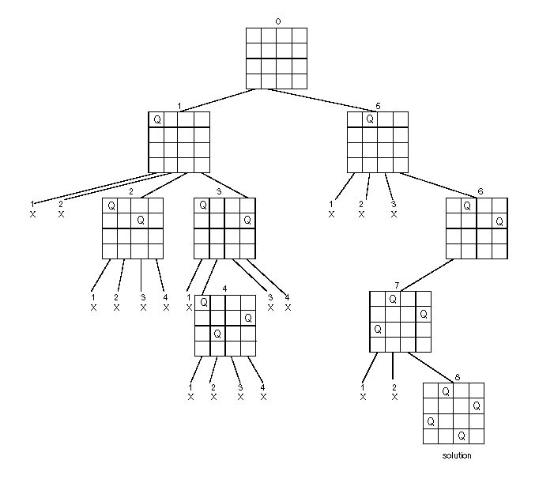
State-Space Tree of the 4-Queens Problem

Slide 7
n-Queens Problem
Algorithm NQueens(k,n)
{
for i=1 to n do
{
if place(k,i) then
{
x[k]=i;
if (k = n) then write (x[1:n]);
else NQueens(k+1, n);
}
}
NQueens(k-1,n);
i= x[k-1]+1;
}

Slide 8
n-Queens Problem
Algorithm place(k,i)
// To place a new queen in the chessboard
// Returns true if a queen can be placed in kth row and ith column, otherwise false.
// x[ ] is a global array whose first (k-1) values have been set
// Abs(r) returns the absolute value of r
{
for j = 1 to k-1 do
if ((x[j] = i) or (Abs (j-k))) then
return false;
return true;
}

Slide 9
Hamiltonian Circuit
Hamiltonian Path: is a path in an undirected graph which visits each vertex exactly once
Hamiltonian circuit: is a cycle in an undirected graph which visits each vertex exactly once and also returns to the starting vertex.
Determining whether such paths and cycles exists is the hamiltonian path problem.
Hamiltonian paths and cycles are named after William Rowan Hamilton

Slide 10
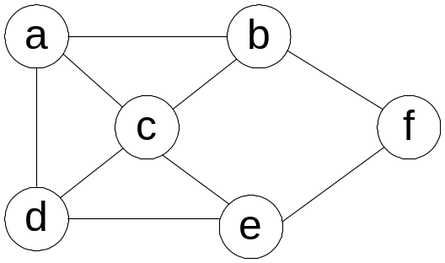
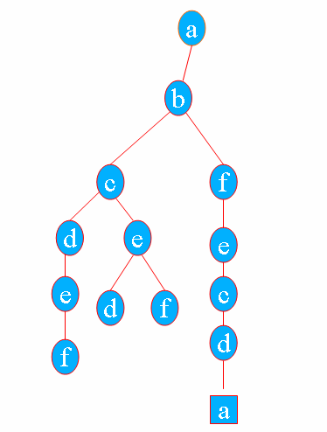
State Space Tree of Hamiltonian Circuit Problem
0
1
2
9
6
3
10
4
7
8
11
5
Dead-end
12
Dead-end
Sol.

Slide 11
SUBSET-SUM PROBLEM
Let S= {s₁,…..,s_{n}} be a set of positive integers, then we have to find a subset whose sum is equal to given positive integer ‘d’.
Sort the elements of the set in ascending order.
s₁<=s₂<=s₃………<=s_{n}
S={1,2,5,6,8} d=9
2 solutions: {1,2,6} and {1,8}

Slide 12
Subset – Sum Problem
Steps:
  The root of the tree represents the starting point, with no decisions about the given elements.
  Its left and right children represent, inclusion and exclusion of s1 in the set being sought
  Going to the left from a node of the first level corresponds to inclusion of s2, while going to right corresponds to exclusion
  A path from the root to a node at the ith level of the tree indicates which of the first i numbers have been included in the subsets represented by that nodeWe record the value of s’, the sum of these numbers in the node.
  If s’ =d, we have a solution to the problem and stop. If all the solutions need to be found, continue by backtracking to the node’s parent.
  If s’ is not equal to d, we can terminate the node as nonpromising if either of the two equalities holds.
  s’+si+1 > d ( the sum s’ too large)
  n
  s’ + ∑ sj < d ( the sum s’ too small)
  j=i+1

Slide 13
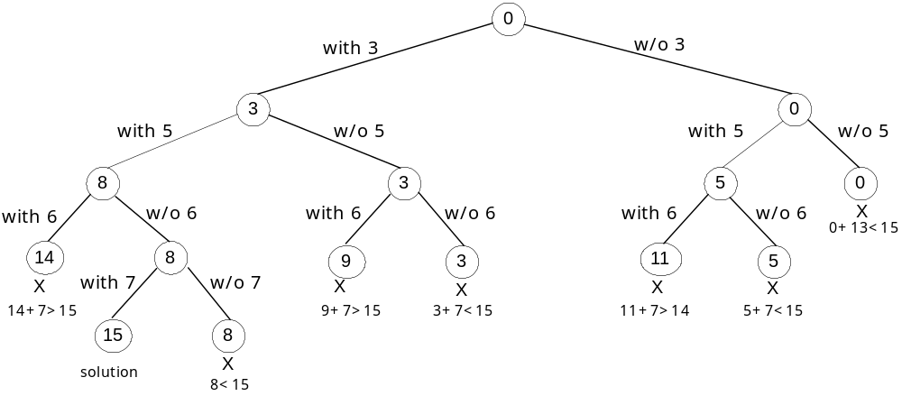
State Space Tree of Subset – Sum Problem
S= {3,5,6,7} and d=15
No. of Nodes in the state space tree is 1+2+2²+…+2^{n} = 2^{n+1} -1

Slide 14
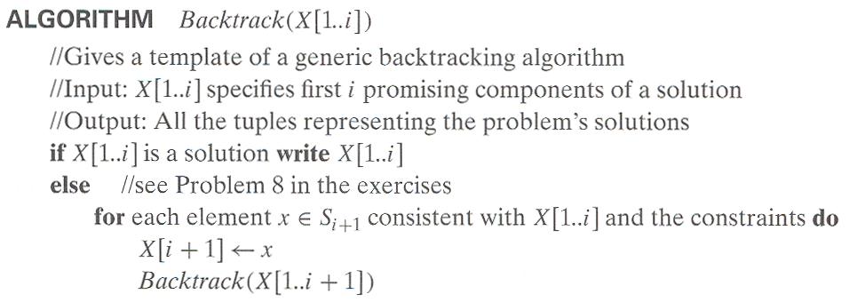
Pseudocode: Backtracking

Slide 15
BRANCH AND BOUND

Slide 16
Branch-and-Bound
Branch and bound (BB) is a general algorithm for finding optimal solutions of various optimization problems, especially in discrete and combinatorial optimization.
It consists of a systematic enumeration of all candidate solutions, where large subsets of fruitless candidates are discarded, by using upper and lower estimated bounds of the quantity being optimized.

Slide 17
Branch-and-Bound
In the standard terminology of optimization problems, a feasible solution is a point in the problem’s search space that satisfies all the problem’s constraints
An optimal solution is a feasible solution with the best value of the objective function

Slide 18
Branch-and-Bound
3 Reasons for terminating a search path at the current node in a state-space tree of a branch-and-bound algorithm:
The value of the node’s bound is not better than the value of the best solution seen so far.
The node represents no feasible solutions because the constraints of the problem are already violated.
The subset of feasible solutions represented by the node consists of a single point—in this case we compare the value of the objective function for this feasible solution with that of the best solution seen so far and update the latter with the former if the new solution is better.

Slide 19
Branch-and-Bound
An enhancement of backtracking
Applicable to optimization problems
For each node (partial solution) of a state-space tree, computes a bound on the value of the objective function for all descendants of the node (extensions of the partial solution)
Uses the bound for:
  ruling out certain nodes as “nonpromising” to prune the tree – if a node’s bound is not better than the best solution seen so far
  guiding the search through state-space

Slide 20
Example: Assignment Problem
Select one element in each row of the cost matrix C so that:
no two selected elements are in the same column
the sum is minimized
Example
Job 1 Job 2 Job 3 Job 4
Person a 9 2 7 8
Person b 6 4 3 7
Person c 5 8 1 8
Person d 7 6 9 4
Lower bound: Any solution to this problem will have total cost
at least: 2 + 3 + 1 + 4 (or 5 + 2 + 1 + 4)

Slide 21
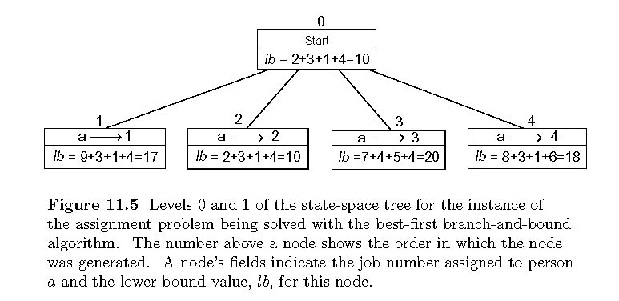
Example: First two levels of the state-space tree

Slide 22
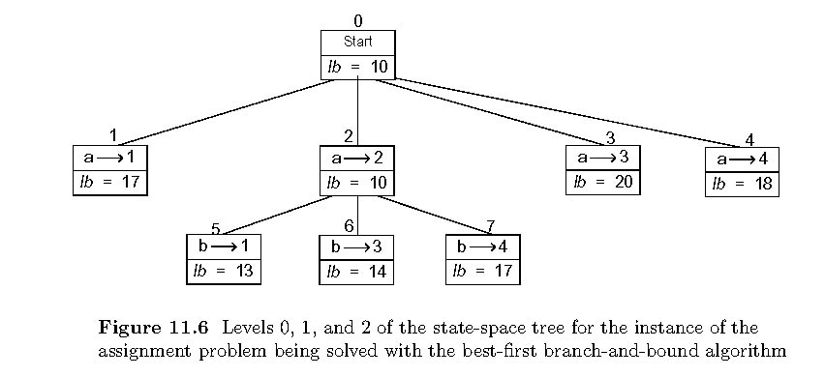
Example (cont.)

Slide 23
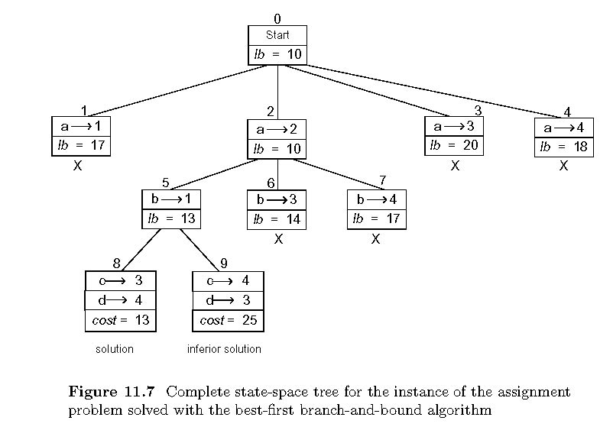
Example: Complete state-space tree

Slide 24
Solution:
Person a – job 2
Person b – job 1
Person c – job 3
Person d – job 4

Slide 25
KNAPSACK PROBLEM
N items of known weights wi and values vi, i=1,2,….n
Knapsack capacity W =10
Item Weight Value Value/Weight
1 4 $40 10
2 7 $42 6
3 5 $25 5
4 3 $12 4
ub = v+ (W-w) (v_{i+1}/w_{i+1})

Slide 26
State space tree of knapsack problem
0
w=0, v=0
ub=100
with 1
w/o 1
1
w=4, v=40
2
w=0, v=0
ub=76
ub=60
with 2
w/o 2
X
inferior to node 8
3
w=11
4
w=4, v=40
ub=70
X
with 3
w/o 3
not feasible
5
w=9, v=65
6
w=4, v=40
ub=69
ub=64
with 4
inferior to node 8
w/o 4
X
7
w=12
8
w=9, v=65
ub=65
X
Optimal Solution
not feasible

Slide 27
Traveling Salesman Problem
For each city i, 1 <= i <=n, find the sum of the distances from city i to the two nearest cities.
Compute the sum s of these n numbers
Divide the result by 2
If all the distances are integers, round up the result to the nearest integer
lb = [ s/2 ]

Slide 28
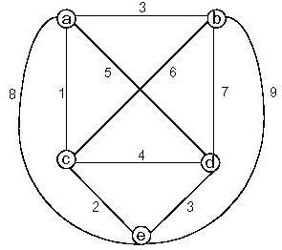
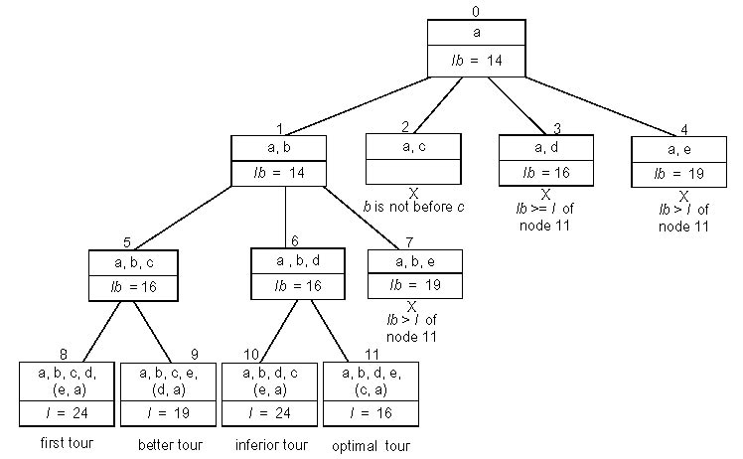
Example: Traveling Salesman Problem

